Slide 1
Customer Segmentation
Using RFM Analysis and K-Means Clustering
UCI Online Retail Dataset
MACHINE LEARNING CAPSTONE PROJECT
CUSTOMERS
DATA
SEGMENTATION
Roberto G. Sanchez
Post Graduate Diploma in Artificial Intelligence and Machine Learning
25 September 2026

Slide 2
02 | Problem & Objective
Customer Segmentation
Using RFM Analysis and K-Means Clustering
UNDERSTAND THE PROBLEM & OBJECTIVE
Business Problem
Machine Learning Objective
The retailer has a large volume of transaction data but lacks a systematic way to identify customers with different purchasing behaviors
Develop an unsupervised customer segmentation model that groups customers based on their purchasing behavior
Method
Transaction Data
Online retail transactions
RFM Features
Recency – Frequency - Monetary
K-Means Clustering
Unsupervised learning
Customer Segments
Distinct customer groups
Success Measures
Silhouette Score
Measures cluster separation and cohesion.
Davies-Bouldin Index
Evaluates cluster compactness and distinctness
Cluster Stability
Consistent results across different runs.
Business Interpretability
Segments are meaningful and actionable for the retailer.

Slide 3
03 | Dataset Collection & Understanding
Customer Segmentation
Using RFM Analysis and K-Means Clustering
Collect & Understand The Data
UCI Online Retail Dataset Overview
4,372
Customers
38
Countries
4,070
Products
1 Year
Time Period
541,909
Transaction Records
25,900
Invoices
Original Variables
InvoiceNo · StockCode · Description · Quantity · InvoiceDate · UnitPrice · CustomerID · Country

Slide 4
04 | Data Preprocessing & Quality
Customer Segmentation
Using RFM Analysis and K-Means Clustering
Ensure Proper Preprocessing & Data Quality
Identifying and handling data quality issues in the raw dataset
Data Quality Issues (Raw Dataset)
From Raw Data To Clean Data
135,080 missing customer ID
135,080 negative quantities
2,517 zero/negative unit prices
Preprocessing
9,288 cancellation invoices
Raw Dataset
Clean Dataset
Remove invalid records
Handle missing values
Filter out cancellations
Remove duplicates
Validate data types and ranges
Contains data quality issues
Ready for future engineering
5,268 duplicate rows
-80,995 to 80,995
Quantity range
Key Takeaway
The raw data set contains several data quality issues that must be addressed to ensure reliable customer segmentation results.
-£11,062.06 to £38,970
Unit Price range

Slide 5
05 | Feature Engineering
Customer Segmentation
Using RFM Analysis and K-Means Clustering
RFM Analysis
Transforming transaction data into customer-level features
RECENCY
FREQUENCY
MONETARY
Days since the customer’s most recent purchase
Number of unique invoices/purchases
Total amount spent by the customer
Measures how recently a customer has purchased
Measures how often a customer purchases
Measures how much a customer spends
Customer-Level Dataset
RFM
Customer-level RFM Features
Log Transformation
Reduce skewness in the data
Standardization
Scale features for clustering
K-Means
Customer segmentation
4,338
Customers x 3 RFM Features
RFM provides an interpretable representation of customer engagement and purchasing value.

Slide 6
06 | Model Selection
Customer Segmentation
Using RFM Analysis and K-Means Clustering
Model Selection – Choosing the Number of Clusters
Evaluating clustering performance using the silhouette score
Selected K = 2
Reason:
Highest silhouette score among tested K values.
Produces interpretable customer groups
More balanced clusters after preprocessing
Suitable for business segmentation
Technical Observation
Before log transformation: 4,312 vs 26
customers
Highly imbalanced
After log transformation: Reduced the influence of extreme-value customers and produced more meaningful segments
Key Takeaway
Although larger values of K were evaluated, K = 2 achieved the strongest clustering quality according to the silhouette score while remaining interpretable for business decision-making.

Slide 7
07 | Final Model
Customer Segmentation
Using RFM Analysis and K-Means Clustering
Final Model Evaluation
Performance metrics and stability analysis of the final clustering model
K-Means – K = 2
Final customer segmentation
Silhouette Score
Davies-Bouldin Index
PCA Variance Retained
Stability
0.4328
0.8925
93.65%
~0.4328-0.4329
Measures cluster separation and interpreted as the higher the better
Measures cluster compactness and interpreted as the lower the better
Amount of variance captured in 2 components
Consistent results across multiple random seeds
Stability Across Random Seeds
Key Insights
The final model produces moderately separated and stable customer segments.
K = 2 provides a good balance between clustering quality, stability, and business interpretability.
Seed 1
Seed 10
Seed 42
Seed 100
Seed 2026
Silhouette remained approx. 0.4328 – 0.4329

Slide 8
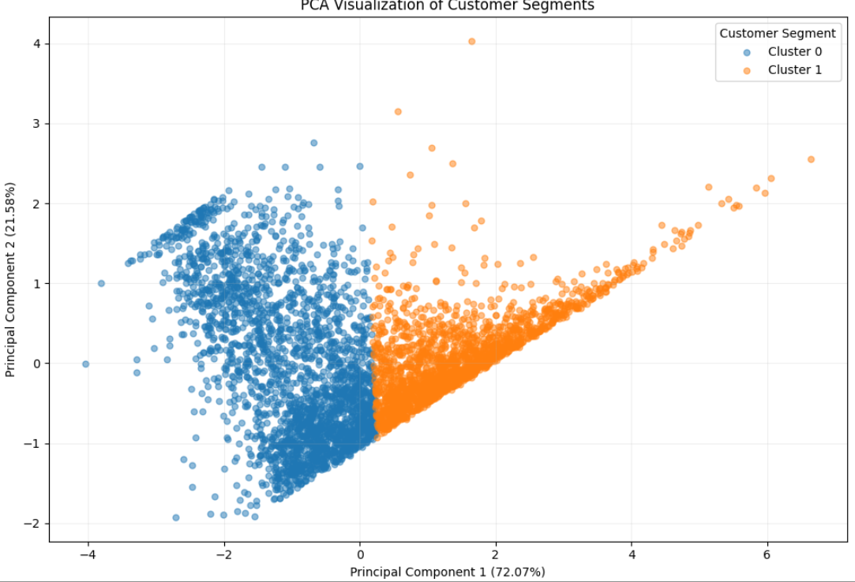
08 | PCA
Customer Segmentation
Using RFM Analysis and K-Means Clustering
PCA Visualization of Customer Segments
Customer segments in a two-dimensional feature space
72.07%
PC1 Variance
21.58%
PC2 Variance
93.65%
Total Variance Retained
About The Visualization
Key Insights
PCA was used for visualization, not for training the K-Means model.
PCA was applied after clustering to project the three standardized RFM features into two dimensions for visualization. The first two components retain 93.65% of the total variance.

Slide 9
09 | Final Segmentation
Customer Segmentation
Using RFM Analysis and K-Means Clustering
Final Customer Segmentation
Understanding what the two customer segments represent
Metric | Cluster 0 Lower-Engagement Customers | Cluster 1 Higher-Engagement Customers
Customers | 2,519 | 1,819
Customer Share | 58.07% | 41.93%
Avg. Recency | 136.29 days | 31.95 days
Avg . Frequency | 1.55 | 8.04
Avg. Monetary | £435.99 | £4,281.99
Revenue Share | 12.36% | 87.64%
Strongest Cluster Separator:
41.93%
87.64%
Frequency
of customers
of customers
Followed by Monetary and Recency
A relatively smaller customer segment accounts for the majority of monetary value.
Cluster 1 customers purchase more recently, more frequently, and spend substantially more, making them the primary revenue-driving customer segment.
Business Interpretation

Slide 10
10 | Key Findings
Customer Segmentation
Using RFM Analysis and K-Means Clustering
Key Findings & Business Implications
So what did the model teach us, and how could the business use it?
Key Findings
Business Implications
01
Customer value is concentrated 41.93% of customers account for 87.64% of total monetary value.
This shows that customer contribution is highly uneven across the customer base.
Higher-Engagement Customers
41.93% of customers | 87.64% of monetary value
Potential Strategies:
Customer retention
Loyalty programs
Personalized offers
Cross-selling and upselling
Priority customer treatment
02
Frequency is the strongest separator: Among the three RFM variables, Frequency had the largest cluster separation, followed by monetary then recency.
This indicates that purchasing frequency is important in comparing the two segments.
Lower-Engagement Customers
58.07% of customers | 12.36% of monetary value
03
The segmentation is stable: The K-Means solution produced very similar silhouette scores across multiple random seeds: ~0.4328 – 0.4329
This supports the reproducibility of the segmentation.
Potential Strategies:
Win-back campaigns
Re-engagement communications
Targeted promotions
Personalized product recommendations
Identify opportunities to increase purchase frequency
RFM + K-Means provides an interpretable framework for differentiating customers based on engagement and purchasing value.
Key Takeaway

